Slide 1
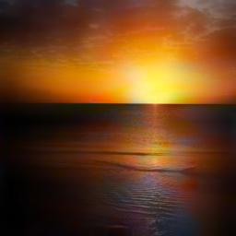
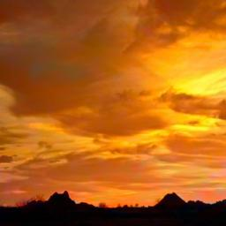
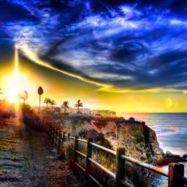
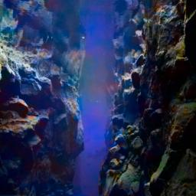
Deep Learning
Assignment
Prepared by David Chong Teak Wei

Slide 2
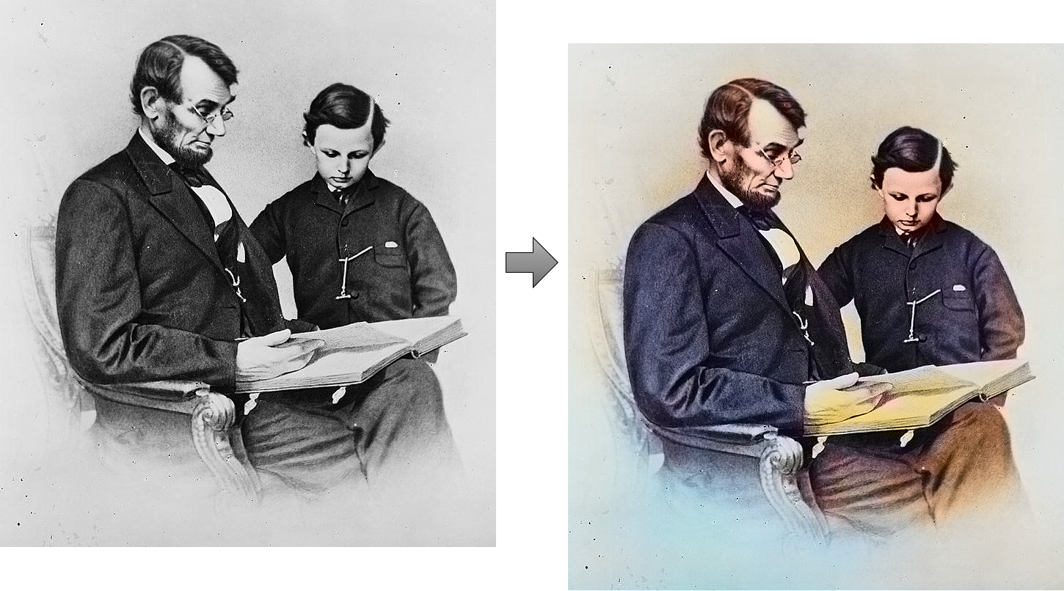
Problem
Develop a machine learning/ Deep learning model for coloring grayscale image to color images. (Feel free to use any data you can obtain as you see fit.)
Problem: Image Colorization
Sample image

Slide 3
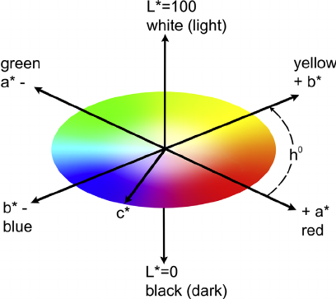
Background Research
Step 1: Distinguish color and grayscale image
LAB color space, aka CIELab color space
L - Lightness [0,100]
A - Red/Green [-128,128]
B - Blue/Yellow [-128,128]
L values represent grayscale color of image
A, B values carry color values
Convert RGB or BGR image to LAB
LAB Color Space

Slide 4
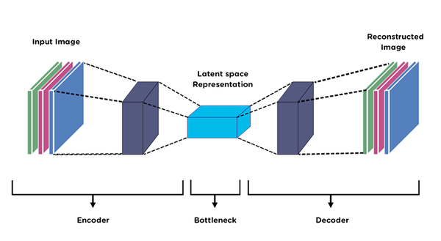
Background Research
Step 2: DL model for image colorization
Autoencoder
Encoder-decoder nets there is exactly one latent space (L) with a nonlinear mapping from the input (X) to that space (E: X->L), and a corresponding mapping from that latent space to the output space (D: L->Y). There's a clear distinction between the encoder and decoder: the encoder changes representation of each sample into some "code" in the latent space, and the decoder is able to construct outputs (Y) given only such codes.
Noise reduction, image colorization
Autoencoder Network

Slide 5
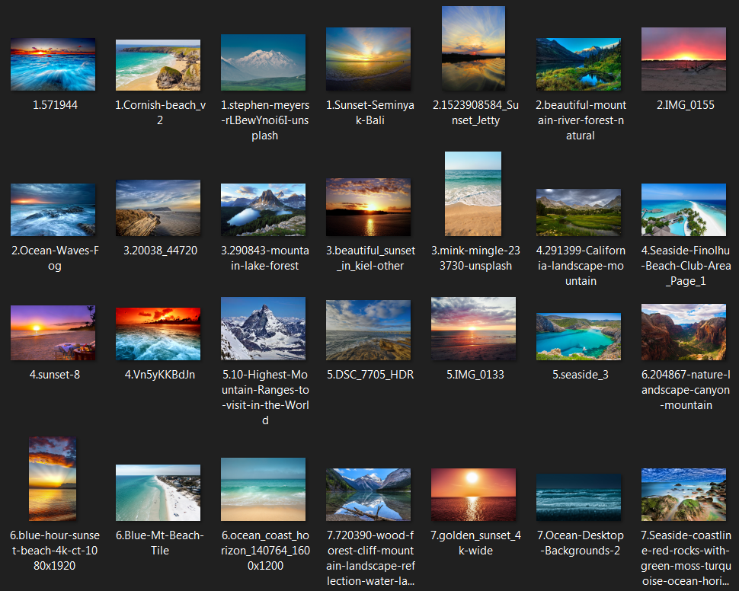
Dataset
Step 3: Data Collection and Preprocessing
1347 training images; 25 testing images
All images come from 4 attributes:
Ocean
Sunset
Seaside
Mountain
Web scrape images from Bings.com
Manually data cleaning (small dataset)
Image normalization, resize and convert RGB to LAB color space
Customized image dataset

Slide 6
Model 1 -
Autoencoder
Image Colorization

Slide 7
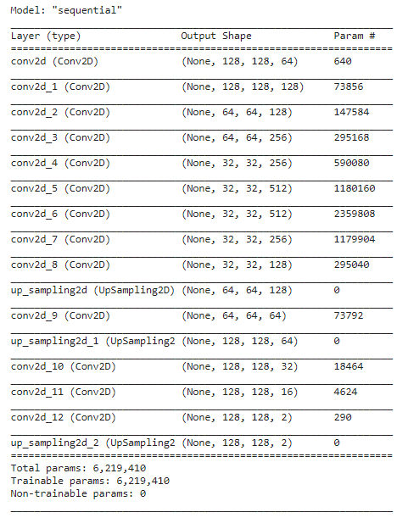
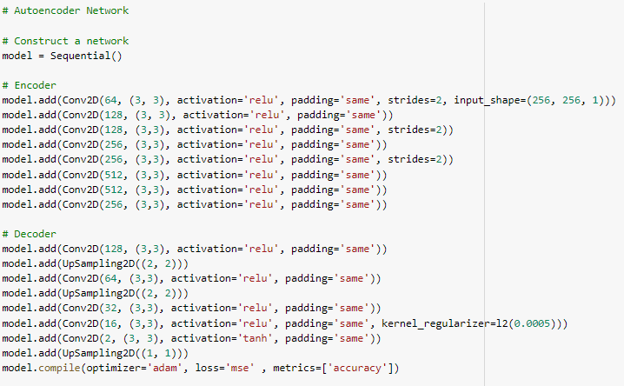
Model 1 - Autoencoder Network
Step 4- Model Construction
3 x strides and 3 x upSampling for degradation and upsampling image
Kernel regularizer is added
13 x Convolutional network layers
Autoencoder Network constructed in Keras
Autoencoder Network

Slide 8
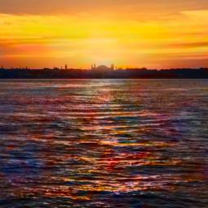
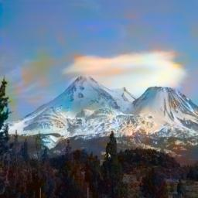
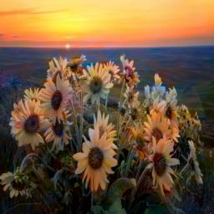
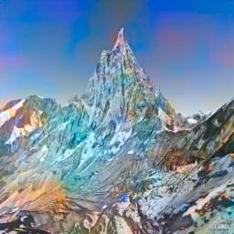
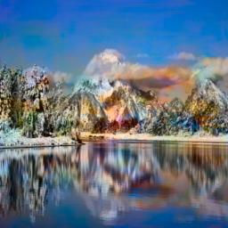
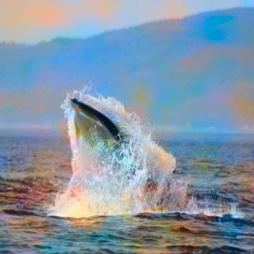
Model 1 - Result
Step 5 - Inference
Highest Accuracy - 94.46%
Trained on Google Colab with GPU
Batch size: 60 for 3000 epoches
Output results

Slide 9
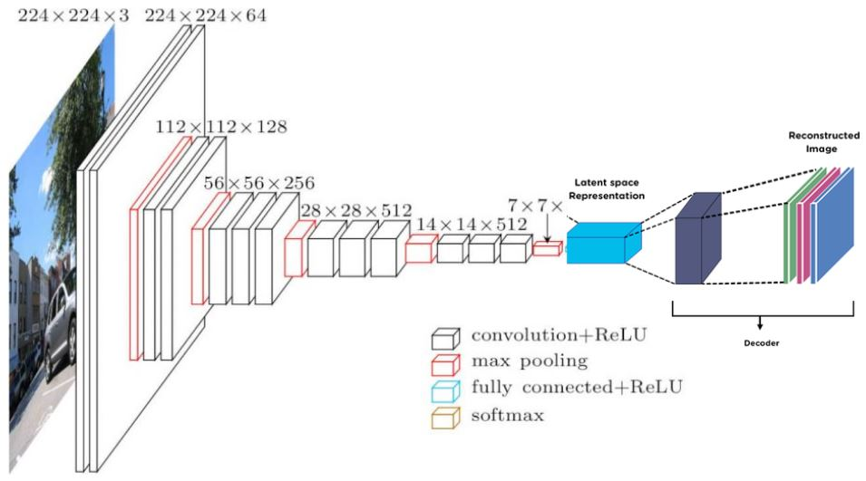
Model 2 -
VGG16 +
Autoencoder
Image Colorization

Slide 10
Model 2 - VGG16 + Autoencoder
Step 6: Try New Model
VGG16 is a convolutional neural network model proposed by K. Simonyan and A. Zisserman from the University of Oxford. The model achieves 92.7% top-5 test accuracy in ImageNet, which is a dataset of over 14 million images belonging to 1000 classes.
VGG16 + Autoencoder network structure

Slide 11
Model 2 - VGG16 + Autoencoder
Inherit the trained weights of 1000 classes classification
Combine the Decoder network
Overall structure shown as figure.
VGG16 network structure

Slide 12
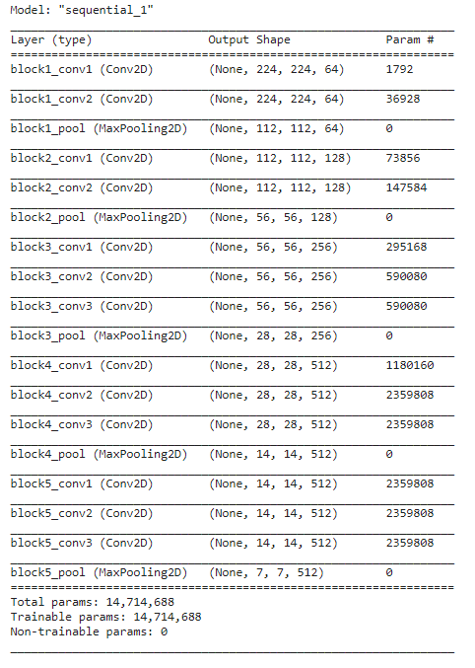
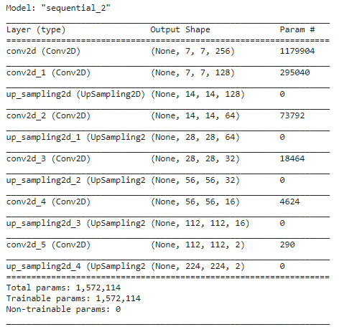
Model 2 -
VGG16 + Autoencoder
6 x Convolutional layers
2 x kernel regularizer l2
Relu activation function for first 5 layers
Last layer has only 2 neurons and Tanh activation function to generate output [-1,1]
Decoder Network
VGG16 - First until layer 19

Slide 13
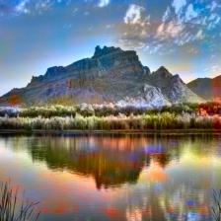
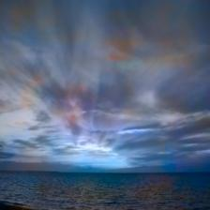
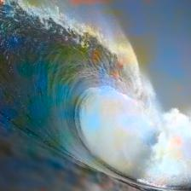
Model 2 - Result
Step 7 - Inference
Highest Accuracy - 91.42%
Trained on Google Colab with GPU
Batch size: 128 for 10000 epoches (with early stopping)
Output results

Slide 14
Conclusion
Autoencoder performs better than the VGG16 + Autoencoder neural network.
Assuming , VGG16 features are more likely for object classification, not landscape images
More data or deeper neural network needed to improve the model
GAN neural network is one of the option to get better result

Slide 15
Thanks !

Slide 16
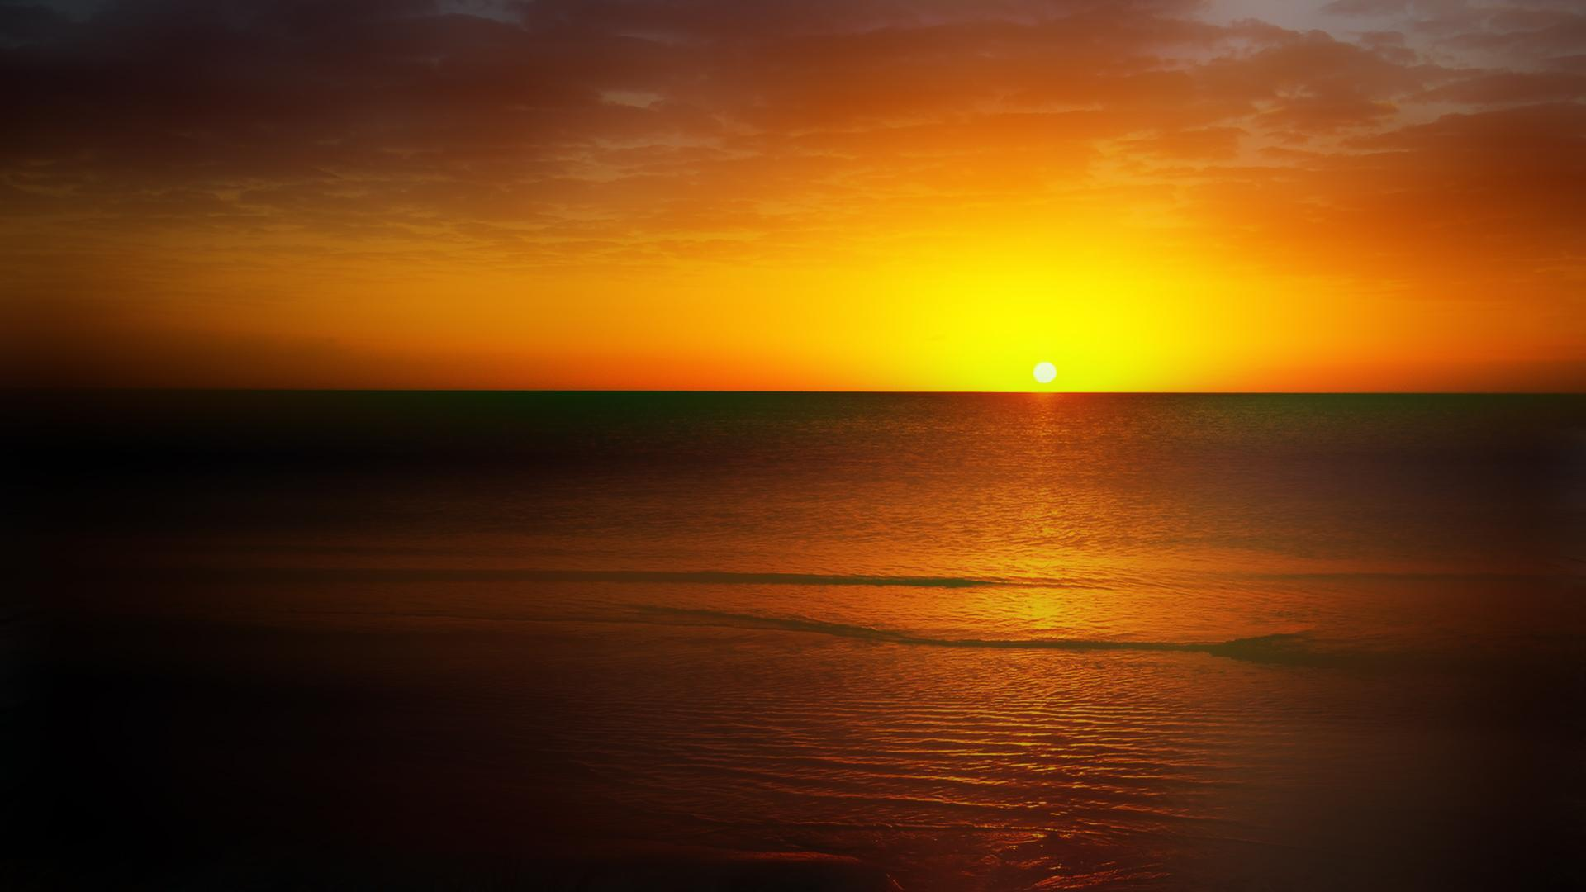
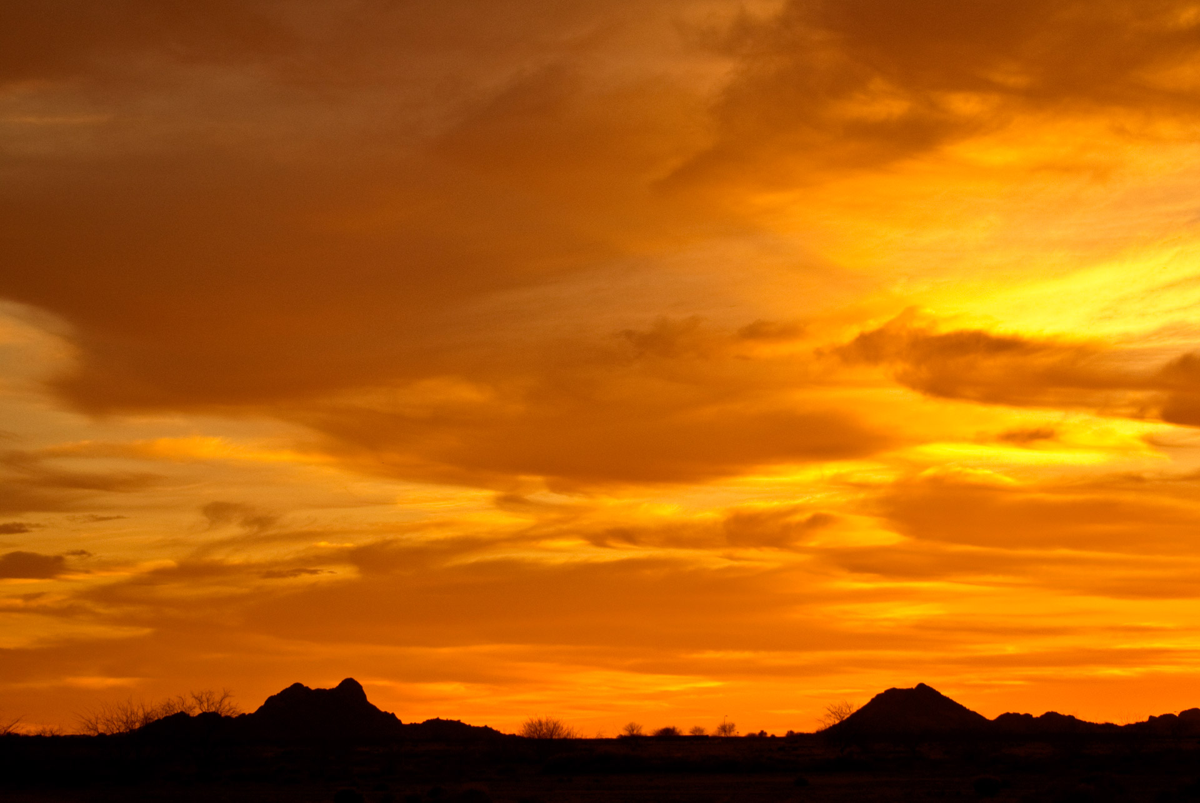
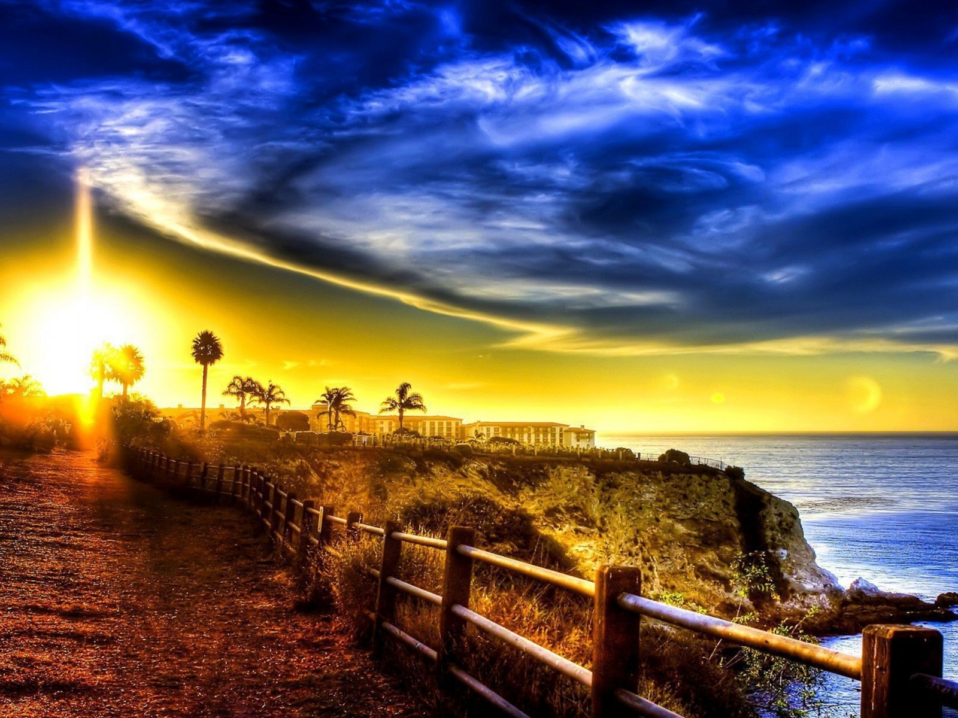
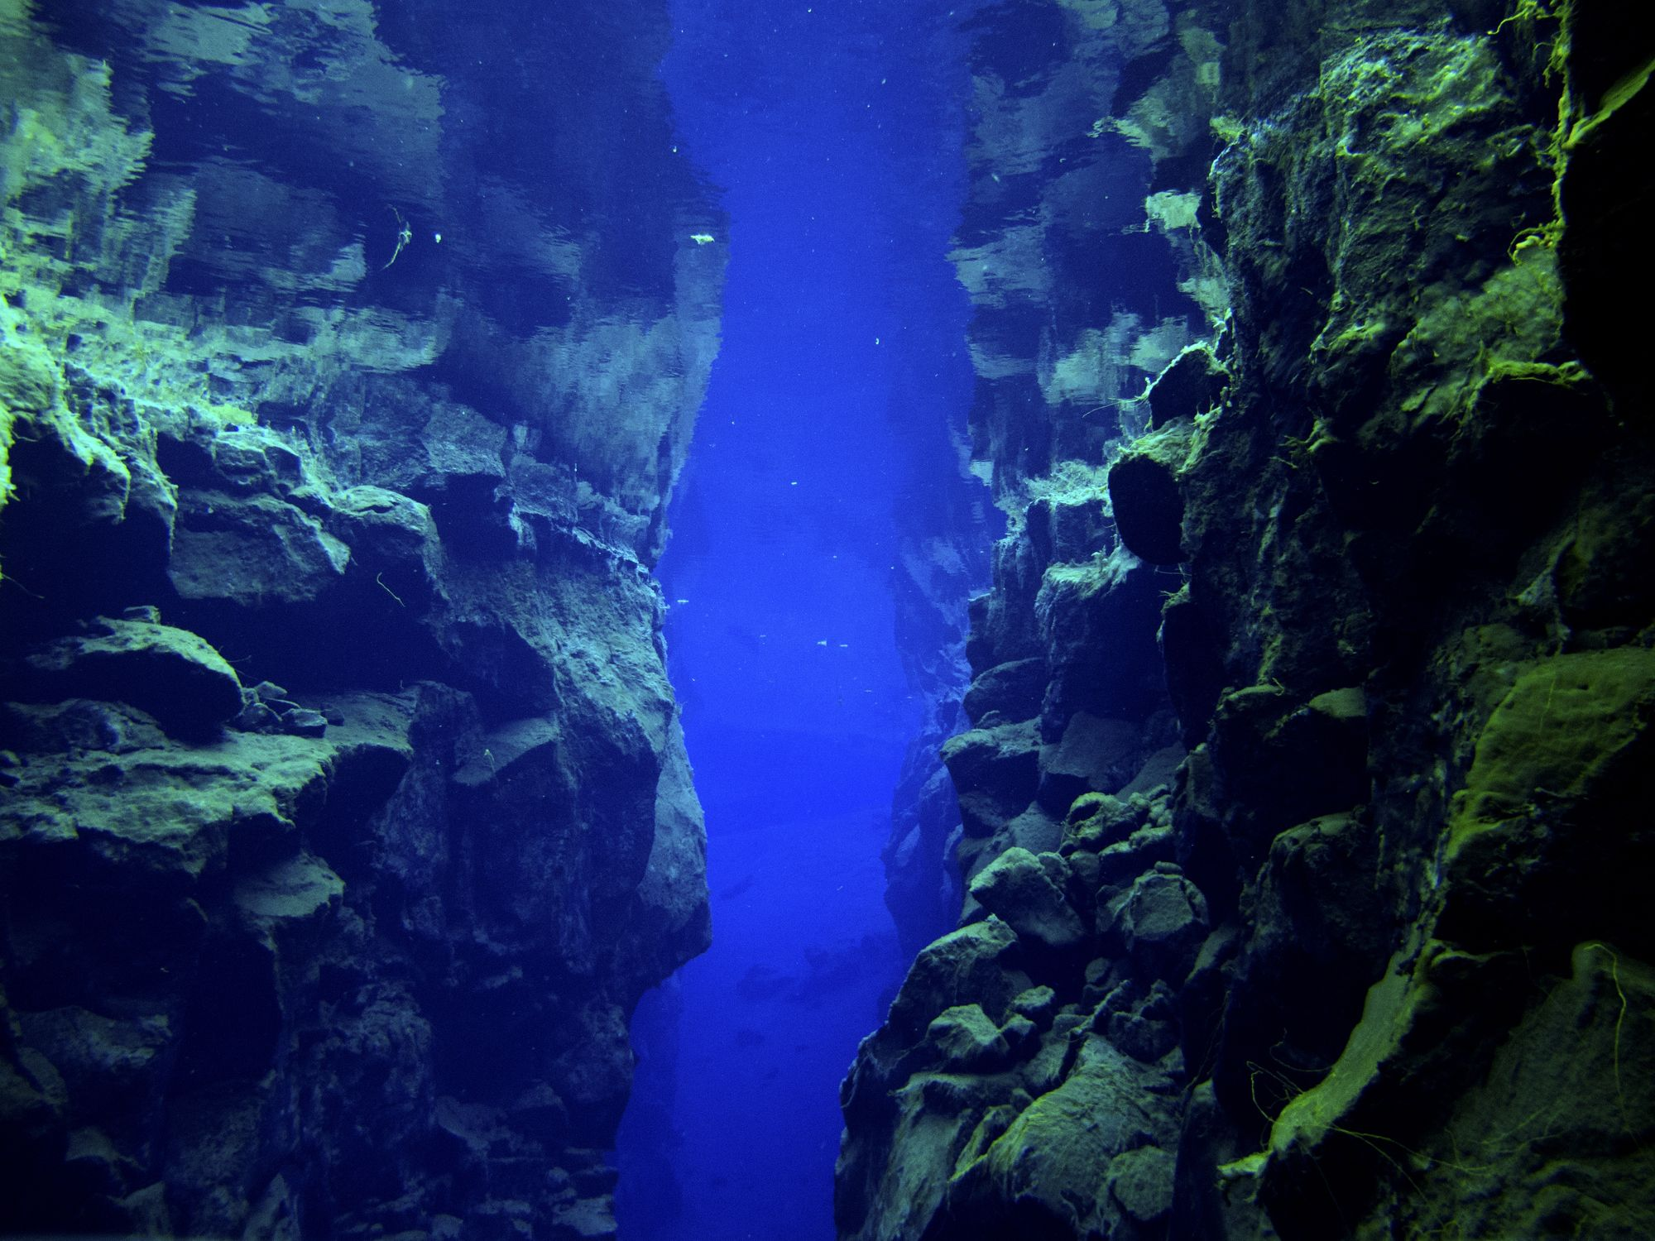
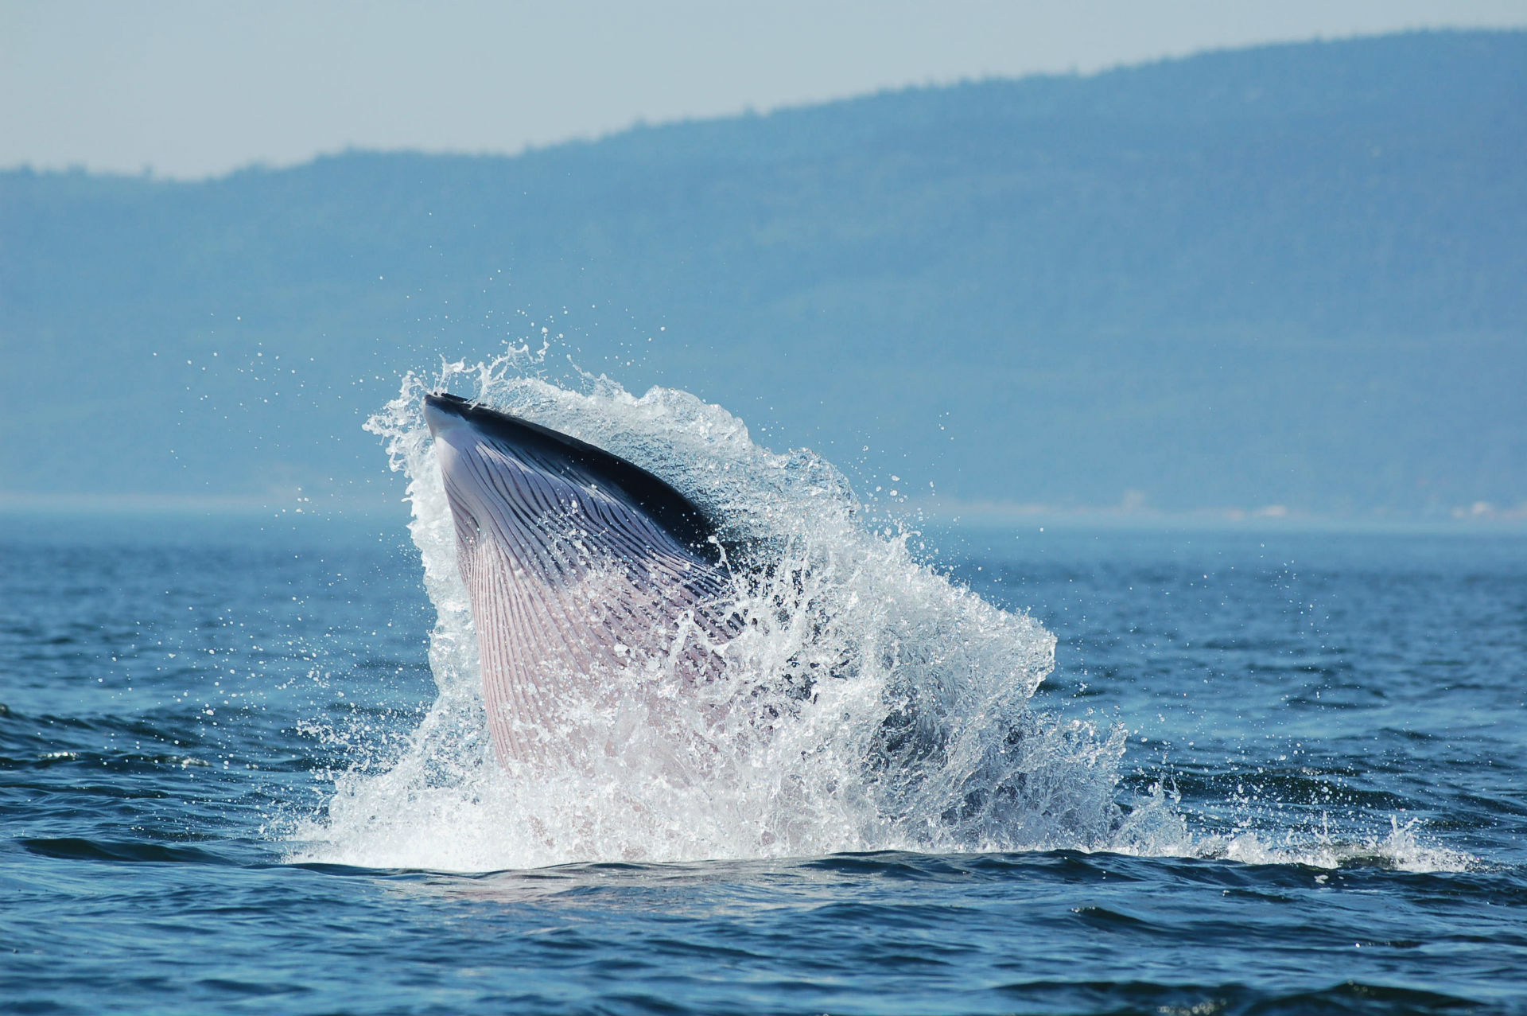
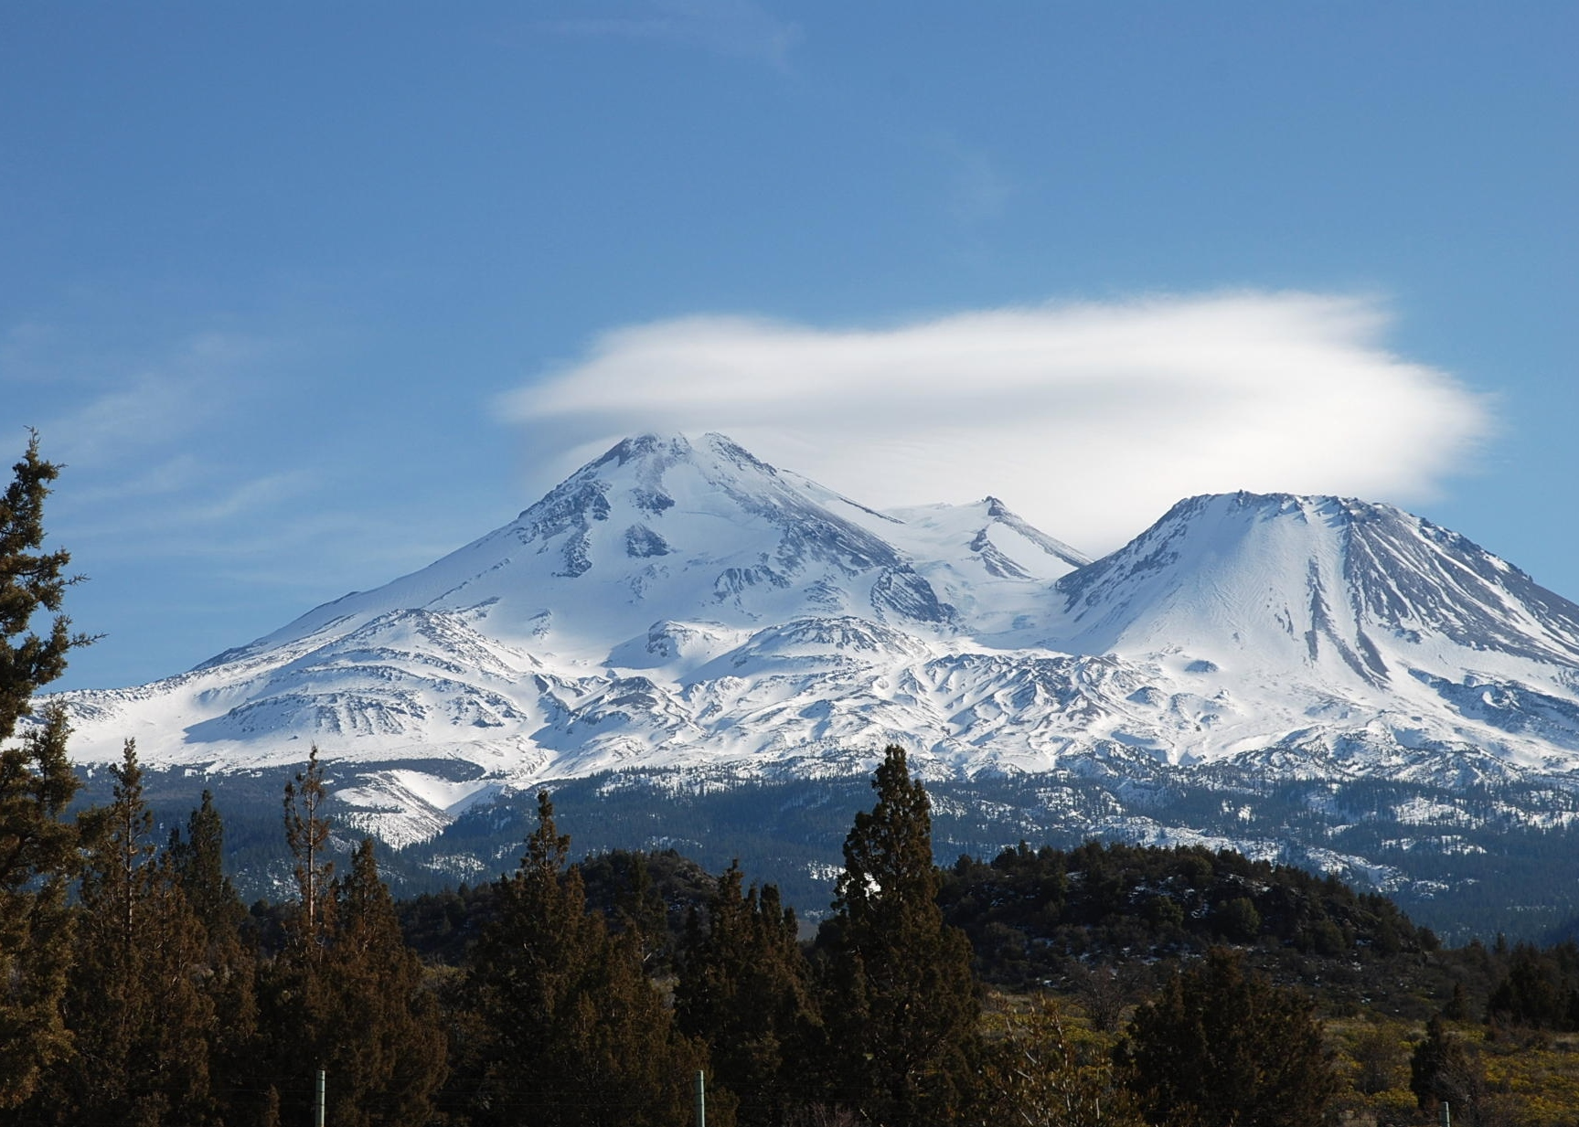
Autoencoder Comparison
Predicted Images
Original Images

Slide 17
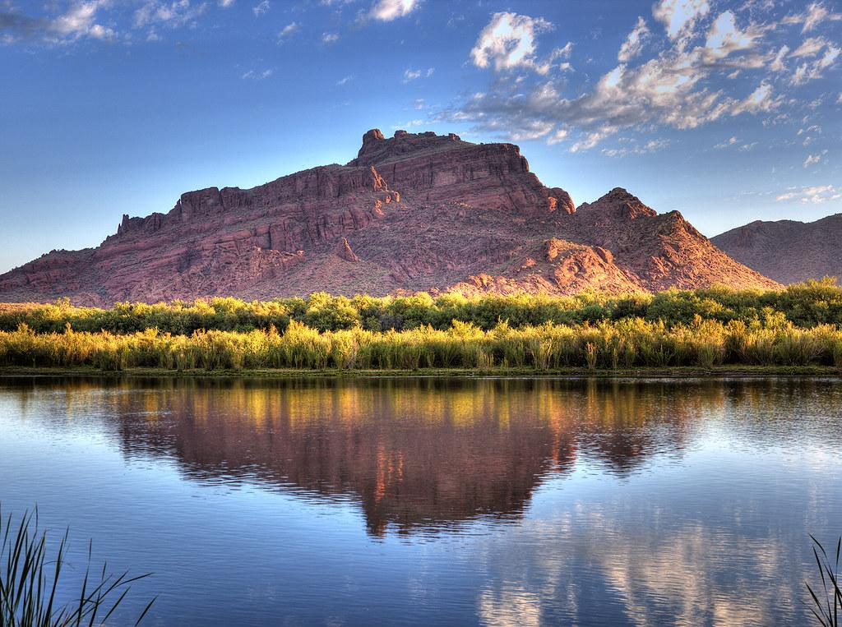
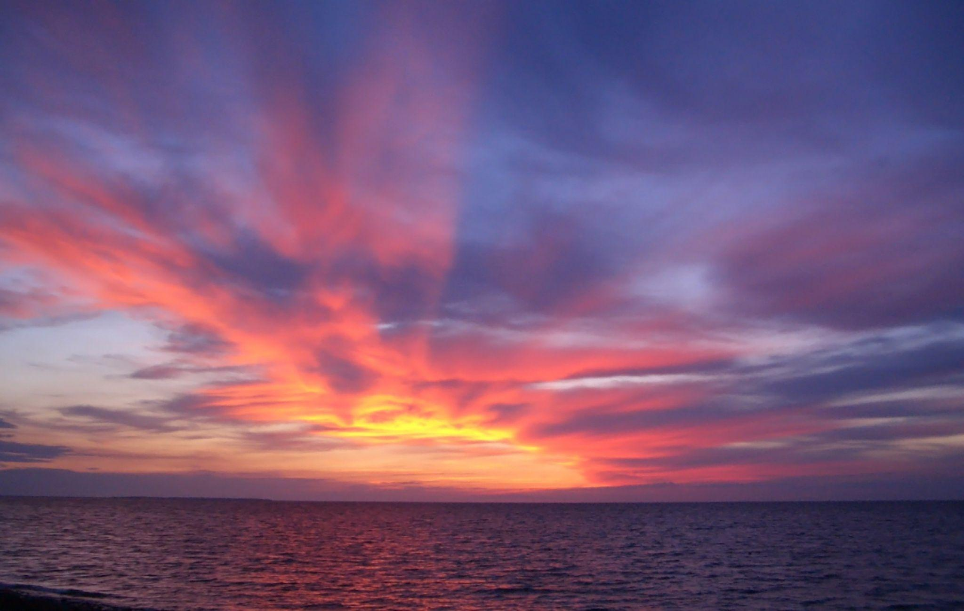
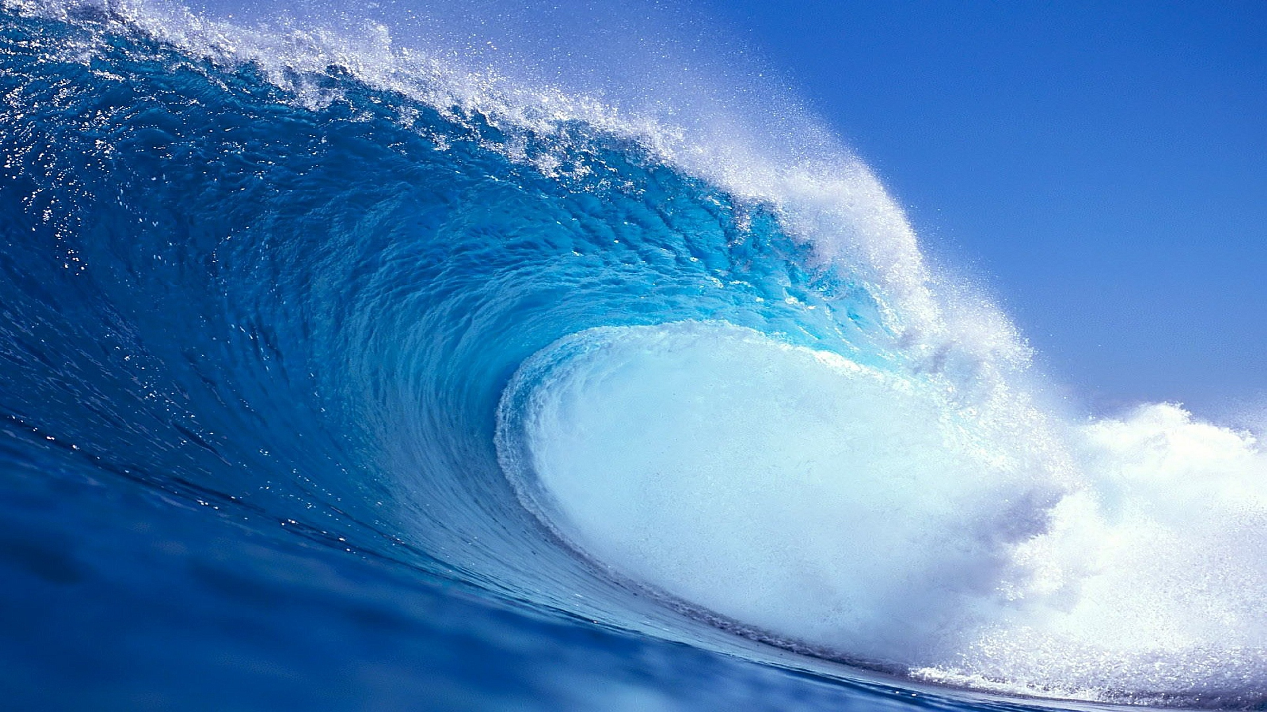
VGG16 + Autoencoder
Predicted Images
Original Images

